Slide 1

Windows CE System
5. Advanced Topics
School of software Engineering
2004

Slide 2
Agenda
BSP Development
Using the Standard CETK Tests

Slide 3
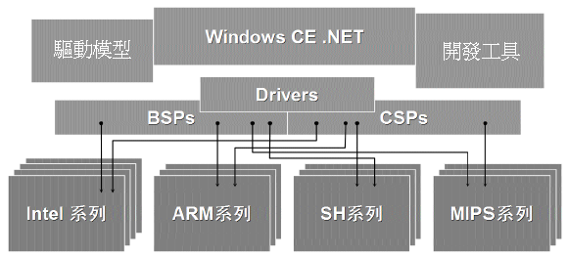
BSP Introduction
A board support package (BSP) is software that implements and supports an OS on a standard development board (SDB). With a BSP, you can rapidly bring up an OS on an SDB and evaluate the features of the OS. Using a BSP, OEMs and independent hardware vendors (IHVs) can reduce the time required to develop a Windows CE–based platform.

Slide 4
BSP, CSP & OAL
CSP : CPU Support Package
  A package that consists of an OAL and device drivers to support a given CPU or CPU companion chipset regardless of what hardware board or hardware platform they are on.
Usually Provided by OS Development corporation. For Win CE, that’s Microsoft

Slide 5
BSP, CSP & OAL (2)
OAL : OEM abstraction layer
  The layer between the Windows CE kernel and the hardware of your target device. This layer facilitates communication between your operating system (OS) and your target device. After being called by the boot loader, the OAL routines implement platform initialization, interrupt service routines (ISRs), the real-time clock (RTC), the interval timer, debugging, interrupt enable/disable, and profiling.
Provided by Hardware OEMs

Slide 6
BSP contains…
Element | Description
Boot loader | During development, downloads the operating system (OS) images.
OEM adaptation layer (OAL) | Links to the kernel image and supports hardware initialization and management.
Device drivers | Support peripherals on-board or are attached at run time.
Configuration files | Once created, a BSP can be reconfigured through environment variables and .bib and .reg file modifications.

Slide 7
BSP Architecture
BSP
OAL
Drivers
Configuration Files
Boot Loader
SDB

Slide 8
Creating BSP, two ways
Writing a whole new BSP yourself
  Should write all OAL, Drivers, Bootloader
  Will cost approximate 20 man-month
Cloning an existing BSP
  The easiest way for you to create a new BSP is to clone an existing BSP that is designed for similar hardware.

Slide 9
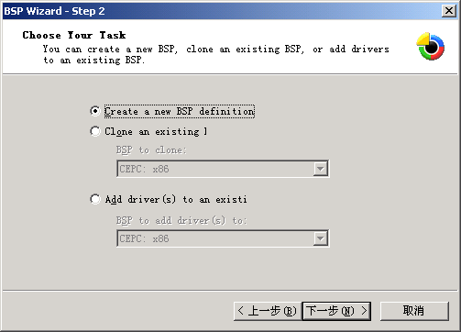
BSP Wizard
Guides you through the process of creating a BSP based on Windows CE. Typically used to generate a .cec file for your BSP
Platform -> BSP Wizard

Slide 10
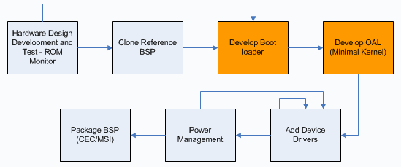
BSP Development process

Slide 11
Bootloader (Optional)
Bootloader is not required system can boot directly into OS image
Bootloader increasingly used in shipping devices for upgrade capability
  Also used to download tests during manufacturing
Bootloader is essential during development to download updated OS Run-Time Images

Slide 12
Role of bootloader
Initializes the target device
  Memory and interrupt controller
  Setting up the clocks and MMU
Controls the boot process
  Directly boot an existing flash RAM image
  Clear RAM before downloading
  Memory read/write test
Downloads the Windows CE image to RAM or flash RAM using:
  Parallel port
  Ethernet port

Slide 13
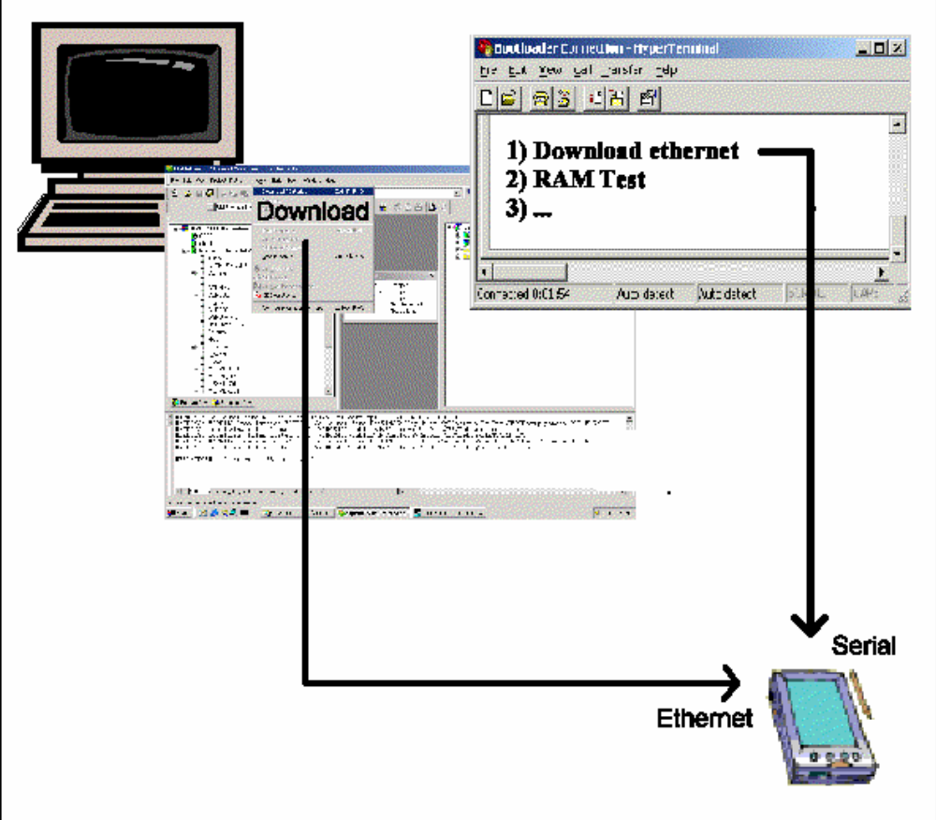
Bootloader communication

Slide 14
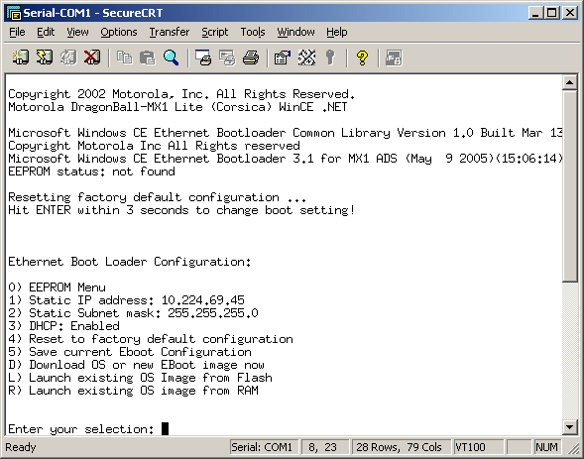
Boot menu

Slide 15
Bootloader Development
Implements some OEM APIs.
Link with Microsoft libs

Slide 16
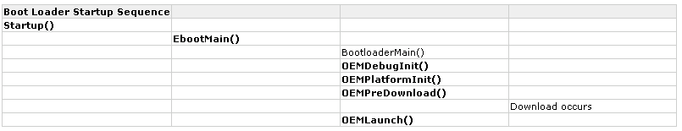
Bootloader Tasks
Function calls in bold text denote functions that OEMs need to implement.

Slide 17
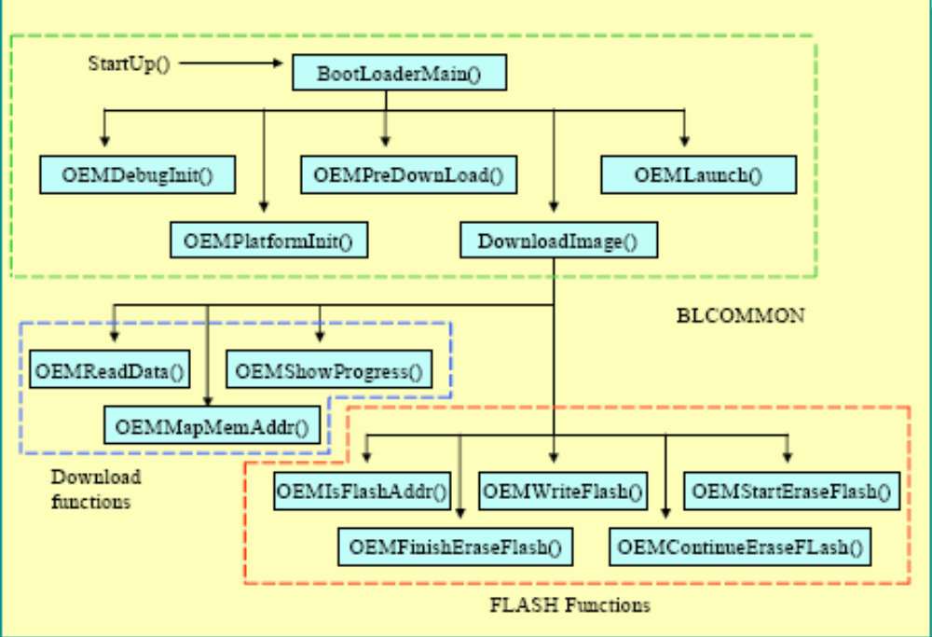
Control flow
C:\WINCE420\PUBLIC\COMMON\OAK\DRIVERS\ETHDBG\BLCOMMON

Slide 18
Bootloader -- Startup
The first code that is run on the device after a hardware reset or run-time reset
Sets the device to supervisor mode
Performs the necessary initialization for the following hardware:
  CPU
  Memory controller
  System clocks
  Serial
  Caches
  Translation look-aside buffers (TLBs)
Modify the Startup.s file, depending on the CPU you are using

Slide 19
Bootloader -- EbootMain
EbootMain is typically the entry point for the C code to be run
End with a call to the BLCOMMON library entry point
The BLCOMMON library source file is located in the Blcommon.c file in the %_WINCEROOT%\Public\Common\Oak\Drivers\Ethdbg directory

Slide 20
Bootloader -- OEMDebugInit
Used to initialize serial UART debugging output.
After OEMDebugInit completes, the Windows CE banner appears indicating that this interface is available.

Slide 21
Bootloader -- OEMPlatformInit
OEM hardware platform initialization function for the clock, PCI interface, or NIC interface.
The NIC interface for downloading the image is assumed for the following download functions.

Slide 22
Bootloader -- OEMPreDownload
Called from BLCOMMON before actually downloading a run-time image.
retrieves the IP address for the device and connects to the development workstation.
Return -1 for Error

Slide 23
Bootloader -- OEMLaunch
OEMLaunch is the last boot loader function called out of BLCOMMON
Responsible for jumping to and launching the run-time image.
Jumps to the first instruction specified by the dwLaunchAddr parameter, which is the location of the run-time image Startup function.

Slide 24
Kernel Development
The scenario is almost the same as Bootloader development
Can reuse the code of bootloader

Slide 25
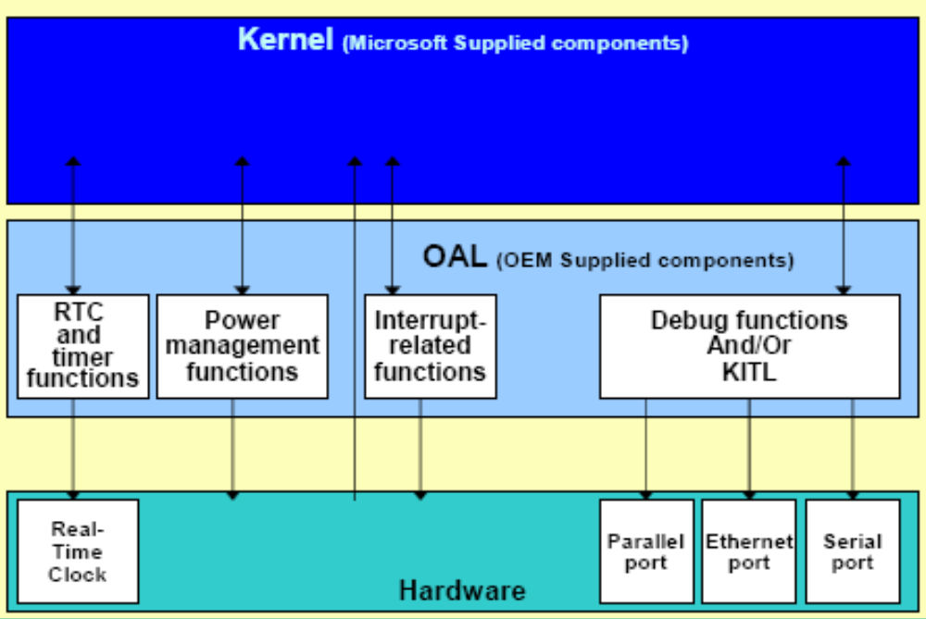
OAL architecture

Slide 26
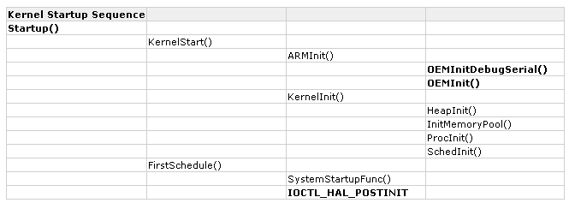
Kernel Development
Function calls in bold text denote functions that OEMs need to implement.

Slide 27
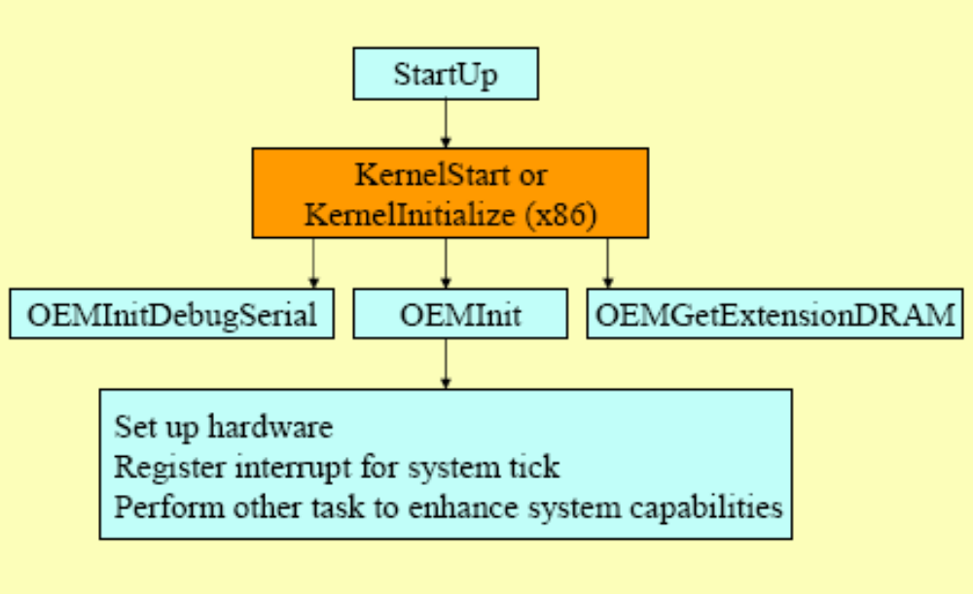
Kernel workflow

Slide 28
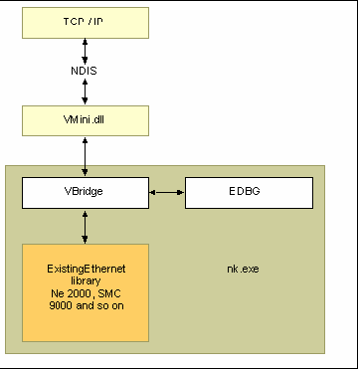
KITL
Designed to provide an easy way for you to support any debug service
Separates the protocol of the communication service from the layer that communicates directly with the communication hardware
reducing your involvement in creating a hardware transport layer
Including the KITL support in the operating system image

Slide 29
Boot Process Big Picture
CPU Power on Reset Vector
[Optional] Startup() in Boot Loader
Startup() in OAL
KernelStart() [ KernelInitialize() For x86 ]
Kernel Calls OEMInit() in OAL
Kernel Completes Initialization
Kernel Loads Filesys.exe
FileSys initializes the registry
Kernel loads applications listed in HKEY_LOCAL_MACHINE\Init

Slide 30
Driver Devlopment
See the previous courses.
Can be added to BSP using BSP Wizard

Slide 31
Demo :
Analyze the Motorola DragonBall BSP

Slide 32
Where are we?
We have finally completed the Windows CE development flow.

Slide 33
Need Hardware Design?
Design & develop your hardware
Get hardware & BSP from OEMs
Develop BSP for your hardware
Need platform customization?
Customize your Win CE platform
Get platform & SDK from OEMs
Export your SDK
Coding & Testing
Release to Manufacture

Slide 34
Overview
Windows CE Test Kit (CETK)
Tux “server”
Kato Logging Engine
Device Driver Loader and Tux Extender (DDLX)
Custom TUX Tests

Slide 35
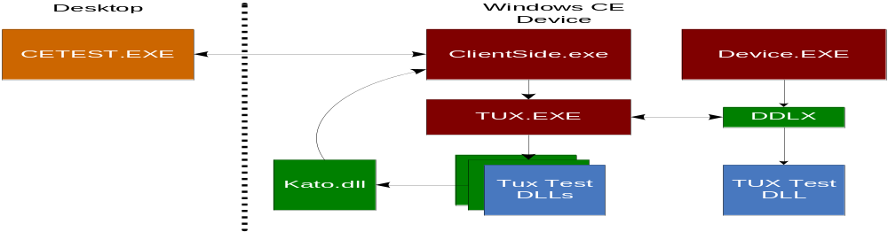
CETK Architecture
Notes:
ClientSide.exe is used to communicate with the desktop CETK server. It launches TUX.EXE with the command line options specified from the desktop Server UI. It is possible to load TUX.EXE in a stand-alone fashion without the use of the remote server. Microsoft provides a number of TUX test DLLs for testing common drivers and aspects of the system. You can also create your own test DLLs for custom drivers.

Slide 36
Windows CE Test Kit (CETK)
Microsoft provided automated test architecture
  Client/Server Architecture supports remote testing
Automated test loading via “Tux”
  Actual tests implemented as DLLs loaded by TUX
Common logging Engine “Kato”
  DLL exposes C and C++ API for logging to the server
CETK Server
  Starts specific test using TUX
  Stores logs and generates reports
  Runs on desktop system for remote testing

Slide 37
TUX Server
TUX.EXE
  Process that hosts TUX test DLLs
Actual Tests implemented in DLLs
  Test DLLs loaded by TUX.EXE
Launched by remote UI application
  CETEST.EXE on the desktop
Can run Standalone on the device as well

Slide 38
KATO Logging Engine
DLL That provides APIs for logging test results
  C++ Class Library
  C Functions
Abstracts logging mechanisms from TUX Tests
  Local file
  Remote connection

Slide 39
Device Driver Loader and TUX Extender (DDLX)
Allows TUX test DLLs to load into the Device Manager Process space
Allows testing of APIs and functionality only available within Device Manager
  Device Manager exposes APIs directly to drivers
  Drivers can expose functionality directly to other drivers

Slide 40
Custom TUX Tests
TUXSKEL
  Microsoft provided TUX test skeleton framework
  Use as a starting “template” for creating custom TUX tests
IDE New Project Wizard generates a custom TUX test based on TUXSKEL structure
  Simpler than copying and modifying TUXSKEL manually

